Slide 1

Final Presentation Assignment-3 Comp 486
Dharmit Kishorbhai Anghan
3644866

Slide 2
Defenders of the Forest
Defenders of the Forest is a tower defense game where players must strategically place defenders on the map to stop attackers from advancing.
The game is set in a fantasy world where different factions, including Fairies, Elves, Humans, Orcs, Trolls, Knights and Golem exist.
The forest, inhabited by Fairies, Elves, and Humans, is constantly under attack from Orcs, Trolls, Knights and Golem who seek to destroy it.
The player's main objective is to defend the forest by strategically placing defenders and using their resources wisely to fend off increasingly challenging waves of enemies.
The game features four levels with different maps and enemy waves, and players can earn coins to unlock stronger defenders.

Slide 3
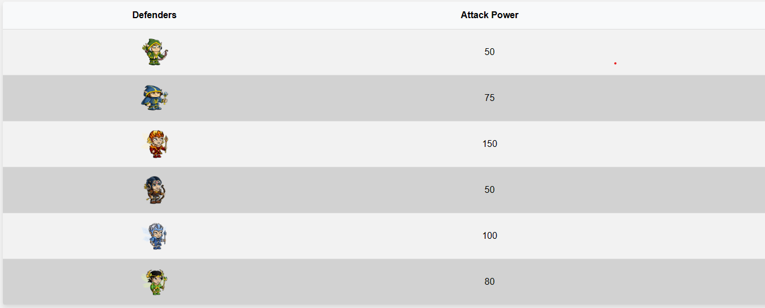
Defenders

Slide 4
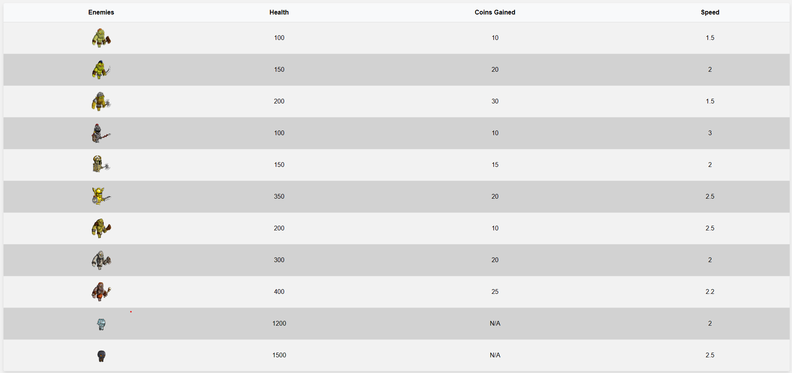
Attackers

Slide 5
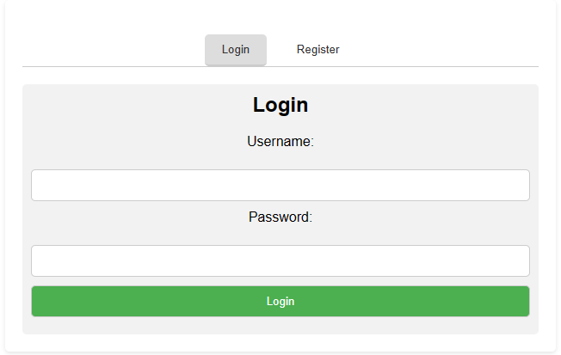
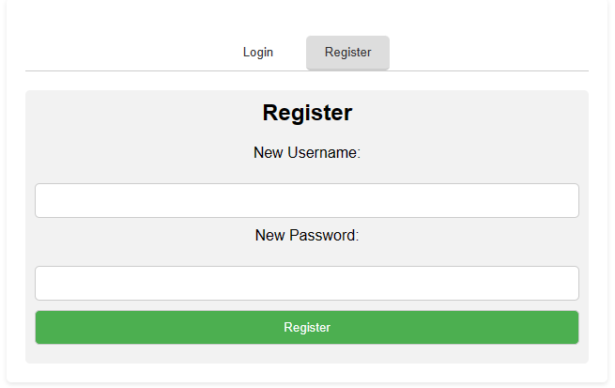
Login and Registration
The game begins with a login and registration interface. If the user isn't logged in, they'll automatically be directed to the login page.
Player can directly login to the game if they are registered or choose to create a new account to play the game.

Slide 6
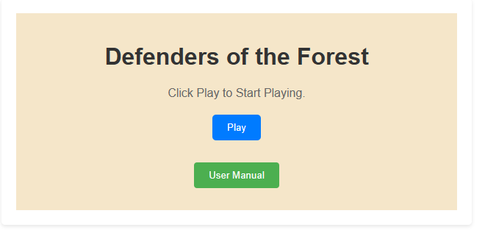
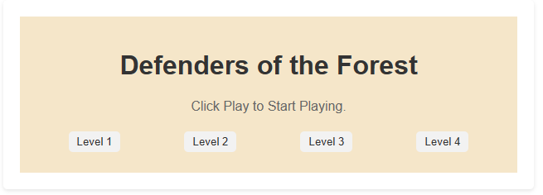
Home Screen
When players sign in, they'll see the home screen. To learn how to play, they can check out the user manual.
When they hit the Play button, they'll need to pick one of four levels to start the game.

Slide 7
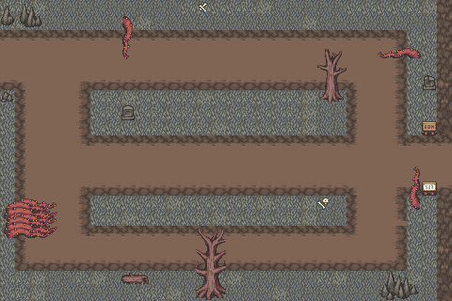
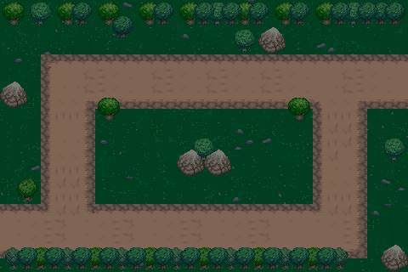
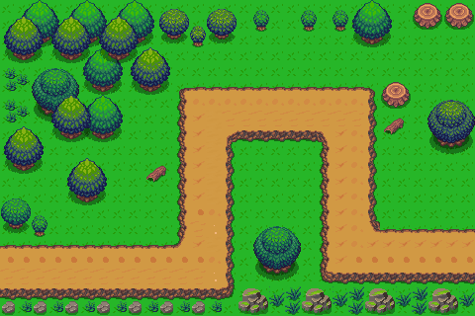
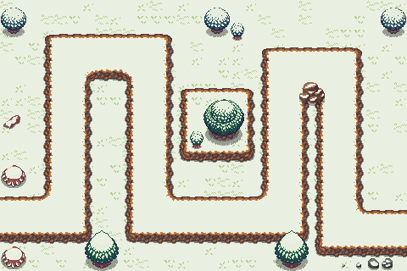
Levels
The game consists of four levels.
Each level offers a distinct set of enemies.
Levels 2 through 4 include 10 waves of enemies.
Levels 3 and 4 feature multi-road maps, enabling enemies to choose from multiple pathways.

Slide 8
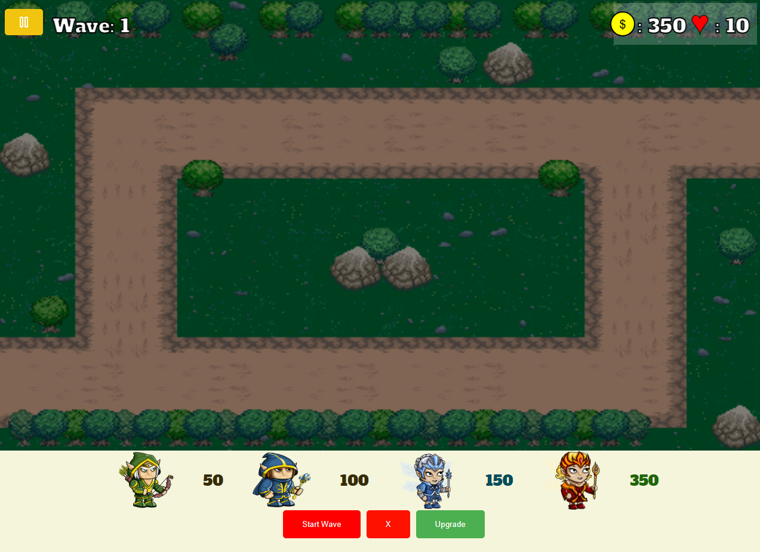
How TO Play
Login or Register: Access the game by logging in or registering.
Start Playing: Click on the Play button to begin.
Select a Level: Choose the desired level to play.
Place Defenders: Click on the defender you wish to place.
Position defenders strategically on the map.
Initiate Enemy Waves: Click on Start Wave to launch enemy waves.
Level 3 and 4 Features:
Remove Defenders:
Click on the remove button and select the defender to remove.
Removing defender would give back 50% the initial cost of respective defender.
Upgrade Defenders:
Click on the upgrade button and choose the defender for upgrade.
Two upgrade levels available:
1st Upgrade: Increases attack power by 20.
2nd Upgrade: Enhances defender's range by 10%.
Defend Against Waves: Protect your base throughout all waves to complete the level.

Slide 9
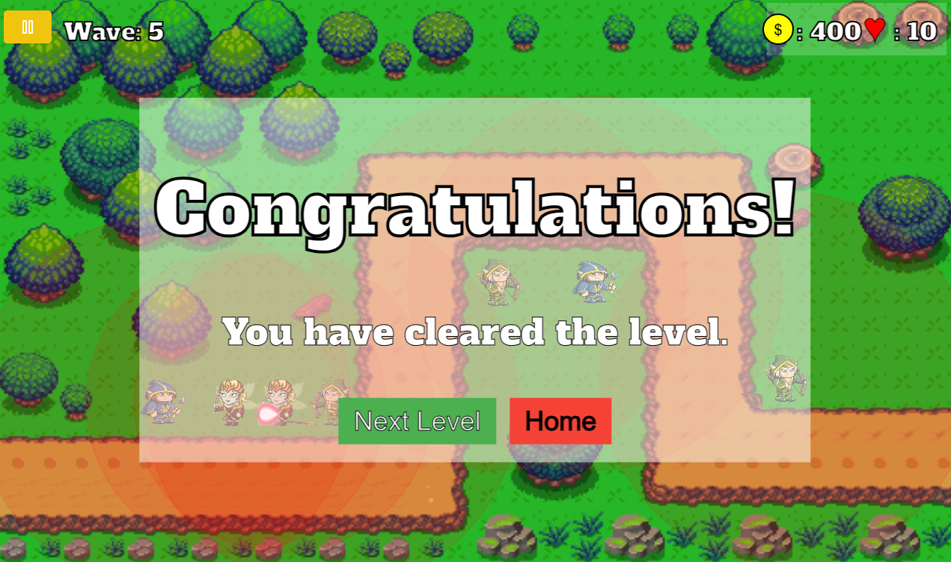
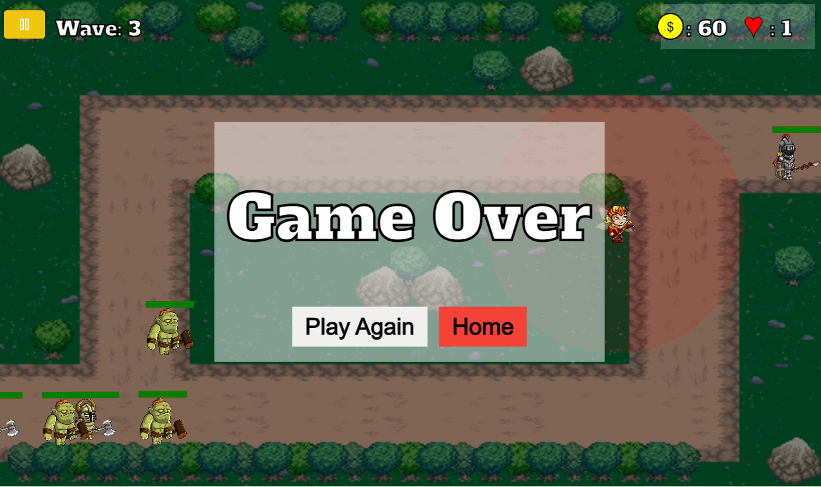
Victory/Game Over Conditions
Upon successfully overcoming all waves without depleting all lives, a congratulatory message will appear. At this point, players can opt to proceed to the next level or return to the home page. However, if all lives are lost during gameplay, the game will conclude. Players then have the choice to either restart the game or return to the home page.
If all lives are lost, the game will come to an end. Players will then be presented with the option to either start a new game or return to the home page.

